Slide 1
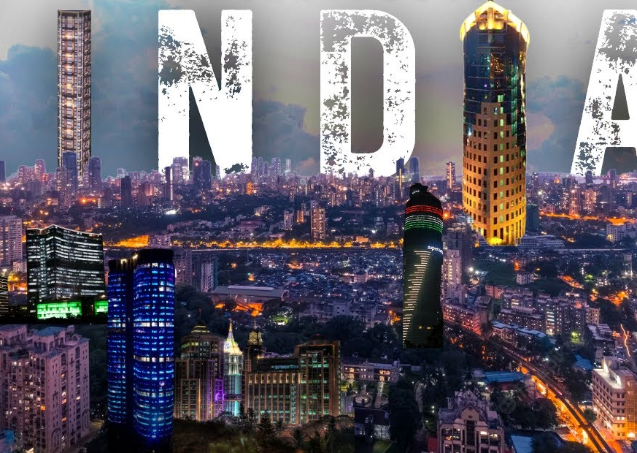


India’s Major Achievements — 2025 (With Statistics)

Slide 2

Economy & Growth
Col R K Sinha’s
GURUDEVAS SSB
ACADEMY | Pune
9890888414/8625888414
Current Economic Size
• India became the 4th largest economy globally (2025)
• Nominal GDP: ~USD 4.2–4.5 trillion
• India overtook Japan in nominal GDP rankings
Growth Performance
• GDP growth rate (2025): ~6.7% (IMF estimate)
• India among the fastest-growing major economies (G20)
Q1 FY2025-26 (April-June 2025): 7.8% real GDP growth.
Q2 FY2025-26 (July-Sept 2025): 8.2% real GDP growth, a six-quarter high.
Global Standing
• Strong domestic demand supported by public capital expenditure
• Rising role in global supply chains under the China+1 strategy

Slide 3
Col R K Sinha’s
GURUDEVAS SSB
ACADEMY | Pune
9890888414/8625888414
Rank (2025) | Country | GDP Size (USD Trillion) | GDP Growth Rate – 2025 (%)
1 | United States | 30.6 | 2.0%
2 | China | 19.4 | 4.8%
3 | Germany | 4.9–5.0 | 0.2%
4 | India | ~4.18–4.25 | 6.7%
5 | Japan | ~4.15–4.18 | 1.1%

Slide 4
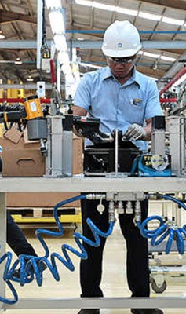
Manufacturing & Infrastructure
Col R K Sinha’s
GURUDEVAS SSB
ACADEMY | Pune
9890888414/8625888414
Manufacturing Growth
• Manufacturing sector growth: ~6.2%
• Manufacturing share targeted towards 25% of GDP under Make in India
Infrastructure Push (2025 Data)
National Highways
• Total National Highways network: 146,145 km
• National Highways constructed in FY 2024–25: 5,614 km
Capital & Infrastructure Spending
• Union Government capital expenditure (FY 2024–25):
₹10.52 trillion (~USD 123 billion)
• Capital expenditure target (FY 2025–26):
₹11.21 lakh crore

Slide 5
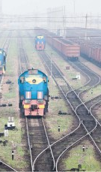
Manufacturing & Infrastructure
Col R K Sinha’s
GURUDEVAS SSB
ACADEMY | Pune
9890888414/8625888414
Rail Infrastructure
• Indian Railways budgetary capital spend crossed
₹2.03 lakh crore by December 2025
Dedicated Freight Corridors
• Eastern & Western DFCs substantially operational, enabling faster freight movement
PM Gati Shakti
• 208 large infrastructure projects worth
₹15.39 lakh crore assessed for integrated planning and execution

Slide 6
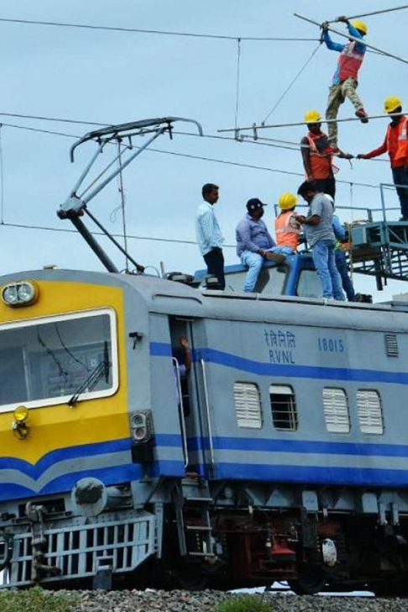
Indian Railways —
Historic Milestones (2025)Near-Complete Railway Electrification
Col R K Sinha’s
GURUDEVAS SSB
ACADEMY | Pune
9890888414/8625888414
• Broad-Gauge (BG) network size: ~70,000 Route Kilometres (RKM)
• Electrified: 99.2% (≈69,426 RKM) — among the world’s most electrified rail systems
• Remaining: 574 RKM (0.8%) in limited sections
• Electrification achieved 2014–2025: 46,900+ RKM (more than double the previous 60 years)

Slide 7
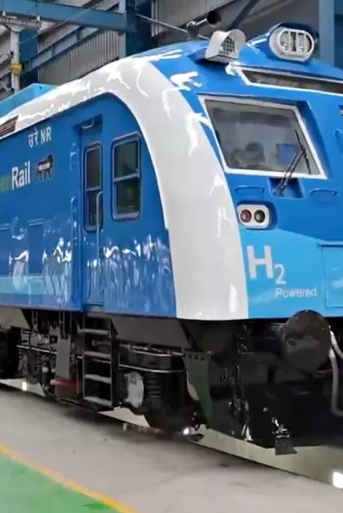
India’s First Hydrogen-Powered Train (Atmanirbhar Bharat)
Col R K Sinha’s
GURUDEVAS SSB
ACADEMY | Pune
9890888414/8625888414
• Manufacturing completed; pilot project of Indian Railways (RDSO-specified)
• World’s longest (10 coaches) & most powerful Hydrogen train on Broad Gauge
• Total power: 2400 kW
– Two Driving Power Cars: 1200 kW each
• Zero CO₂ emissions (only water vapour)
• Green hydrogen plant (electrolysis-based) established at Jind, Haryana
• Major step toward next-generation clean rail traction

Slide 8
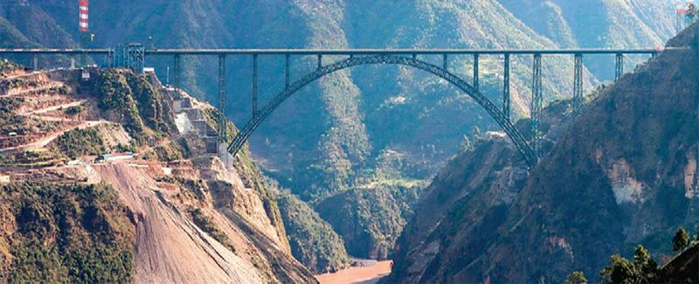
Col R K Sinha’s
GURUDEVAS SSB
ACADEMY | Pune
9890888414/8625888414
Kashmir Rail Connectivity — USBRL
• Udhampur–Srinagar–Baramulla Rail Link (USBRL) fully operational
• Inaugurated: 6 June 2025
• Enables all-weather, year-round rail connectivity between Kashmir Valley and the rest of India
World’s Highest Railway Bridge — Chenab Bridge
• Location: Katra–Banihal section (USBRL)
• Height: 359 metres above river bed (World’s highest railway bridge)
• Total length: 1,315 metres
• Main arch span: 467 metres

Slide 9
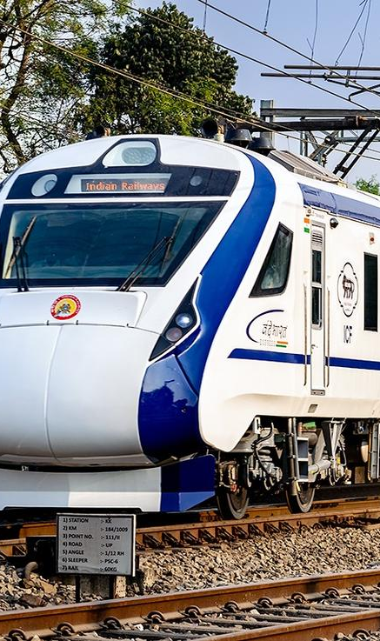
Vande Bharat & Rail Modernisation
Col R K Sinha’s
GURUDEVAS SSB
ACADEMY | Pune
9890888414/8625888414
Vande Bharat Trains (Semi-High-Speed Rail)
• 136 Vande Bharat services operational as of
26 December 2024 (official Indian Railways figure)
• Expanded to ~150 services by August 2025 through additional flag-offs
Semi-High-Speed / High-Speed Rail Progress
• 2,138 km of high-speed rail corridors operational
• Mumbai–Ahmedabad High-Speed Rail project:
~300 km of viaduct completed by mid-2025

Slide 10
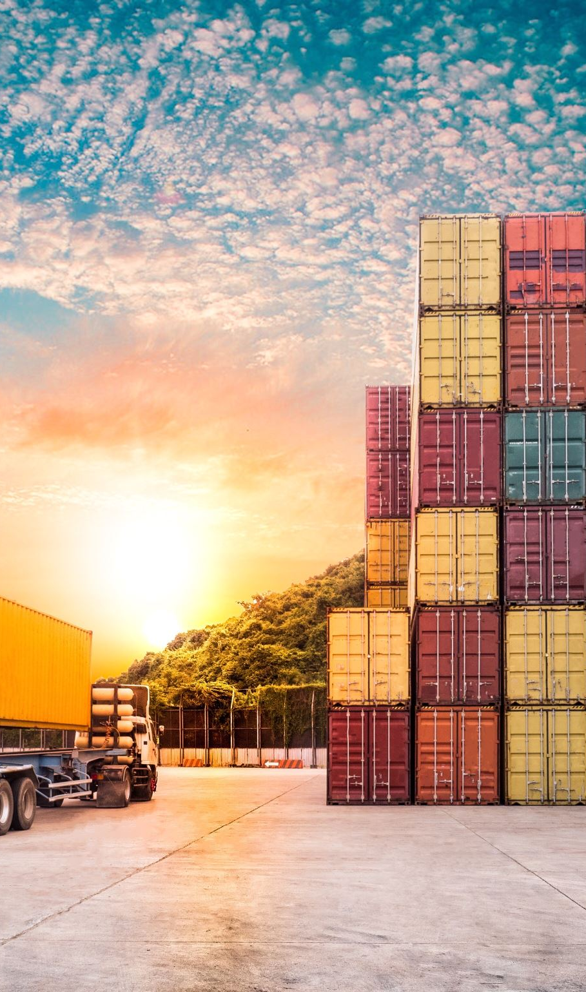
Logistics & Transport Efficiency
Col R K Sinha’s
GURUDEVAS SSB
ACADEMY | Pune
9890888414/8625888414
Logistics Performance Index (World Bank)
• India’s LPI ranking improved from:
– 44 (2018) → 38 (2023)
Logistics Reform Focus
• Multimodal transport integration
• Port modernisation and hinterland connectivity
• Digitisation of customs and logistics processes
Logistics Cost Target
• Baseline logistics cost: ~14% of GDP
• Government target: ~8% of GDP

Slide 11

Startup Ecosystem & Innovation
Col R K Sinha’s
GURUDEVAS SSB
ACADEMY | Pune
9890888414/8625888414
Startup Numbers (2025)
• 180,000+ registered startups
• 3rd largest startup ecosystem globally
• 120+ unicorns (valuation > USD 1 billion)
Startup Valuation
• Combined valuation: USD 350+ billion

Slide 12
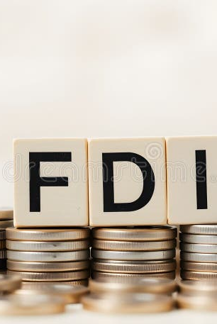
Foreign Investment & Global Confidence
Col R K Sinha’s
GURUDEVAS SSB
ACADEMY | Pune
9890888414/8625888414
FDI Inflows
• FDI inflows (FY 2024–25): ~USD 81 billion
• ~18% year-on-year increase
Key Sectors Attracting FDI
• Manufacturing
• Services
• Digital & electronics
• Renewable energy
Investor Confidence Drivers
• Stable policy regime
• Large domestic market
• Long-term growth visibility

Slide 13
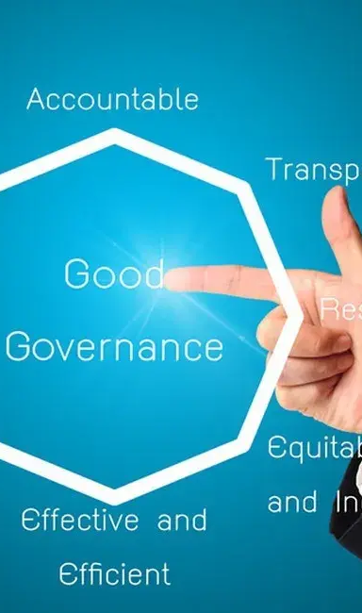
Good Governance & Policy Reforms
Col R K Sinha’s
GURUDEVAS SSB
ACADEMY | Pune
9890888414/8625888414
Governance Model
• “Minimum Government, Maximum Governance”
Digital Public Infrastructure (DPI)
• Aadhaar-based service delivery
• Direct Benefit Transfer (DBT) reducing leakages
• Online clearances and e-governance platforms
Global Recognition
• India’s DPI model studied and adopted by multiple developing nations
• Recognised by the World Bank, IMF, and UN agencies

Slide 14
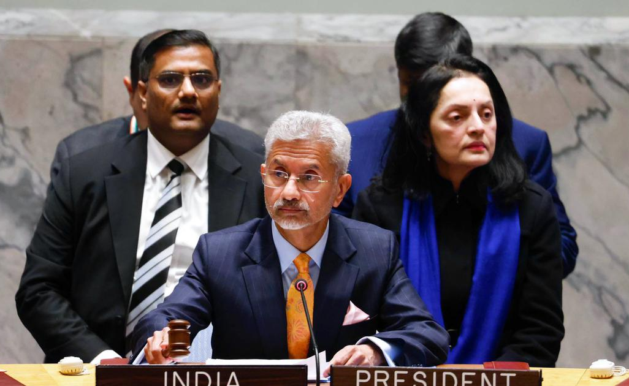
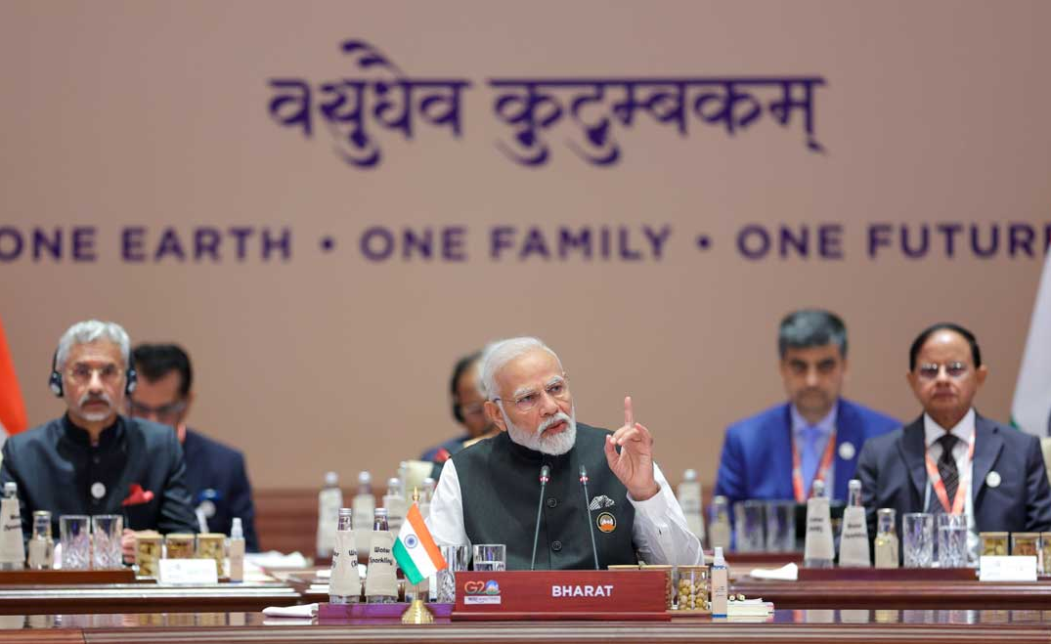
Col R K Sinha’s
GURUDEVAS SSB
ACADEMY | Pune
9890888414/8625888414
Diplomacy Reform

Slide 15
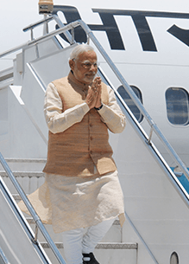
Prime Minister Narendra Modi’s Foreign Visits in 2025
USA — 12-15 Feb 2025
Visited Washington DC for bilateral talks with US leadership and strategic consultations.
France — 10-12 Feb 2025
Co-chaired AI Action Summit, reviewed India-France 2047 roadmap & inaugurated India’s first consulate in Marseille.
Mauritius — 11-12 Mar 2025
Attended 57th National Day celebrations and strategic discussions.
Sri Lanka — 4-6 Apr 2025
State Visit; inaugurated Indian-assisted development projects & strengthened bilateral cooperation.
Saudi Arabia — 22-23 Apr 2025
State Visit focused on energy, investment & strategic partnership discussions.
Cyprus — 15-16 Jun 2025
Visited Nicosia; discussed economic ties & trade corridor potential.
Croatia — 18 Jun 2025
First ever visit; bilateral talks with leadership and partnership strengthening.
Ghana — 2-3 Jul 2025
First India-Ghana bilateral visit in decades; high-level talks & parliament address.

Slide 16
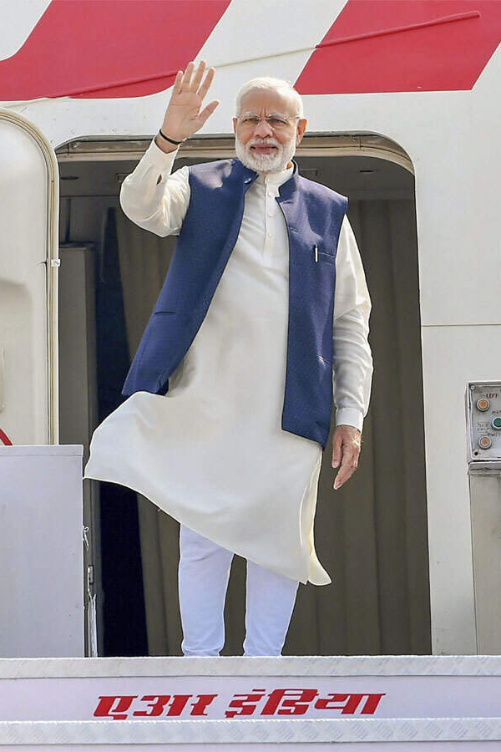
Trinidad & Tobago — 3-4 Jul 2025
Official visit; addressed joint session of parliament & strengthened diaspora ties.
Argentina — 4-5 Jul 2025
Deepened strategic partnership through bilateral discussions.
Brazil — 5-8 Jul 2025 (BRICS Summit)
Attended 17th BRICS Summit; broad strategic engagements.
United Kingdom — 23-24 Jul 2025
Official visit; discussed trade, economic partnership & CETA.
Maldives — 25-26 Jul 2025
Guest of honour at Independence Day; bilateral cooperation announcements.
Japan — 29-30 Aug 2025
15th India-Japan Annual Summit to review strategic partnership.
China (SCO Summit) — 31 Aug-1 Sep 2025
Attended SCO Summit in Tianjin at invitation of President Xi Jinping.
Oman, Ethiopia, Jordan — Dec 15-18 2025
Multinational engagements in West Asia & Africa to deepen cooperation.

Slide 17
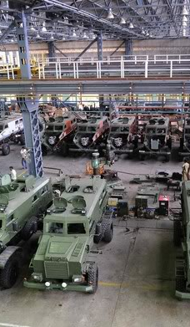
Defence & Strategic Capability
Col R K Sinha’s
GURUDEVAS SSB
ACADEMY | Pune
9890888414/8625888414
Indigenous Defence Production
• Defence production crossed ₹1.3 lakh crore+
Defence Exports
• Defence exports crossed ₹21,000 crore+
• Exporting to 90+ countries
Strategic Strength
• Induction of indigenous missiles, drones, and naval platforms
• Strengthening of border and maritime security

Slide 18
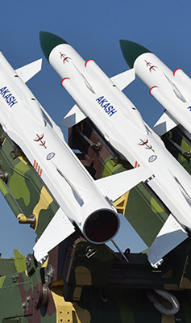
Col R K Sinha’s
GURUDEVAS SSB
ACADEMY | Pune
9890888414/8625888414
Indigenous Missiles Tested (India)
• Agni-Prime (Agni-P) — Medium-range ballistic missile — 21 Sept 2025
• BrahMos — Supersonic cruise missile — Apr 2025
• BrahMos (Naval variant) — Ship-launched cruise missile — May 2025
• Astra Mk-1 — Air-to-air BVR missile — Jan 2025 (operational firing)
• Astra Mk-2 — Extended-range air-to-air missile — Oct 2024 (advanced trial)
• ULPGM-V3 — UAV-launched precision missile — Jul 2025
• MIGM — Naval multi-influence ground mine — May 2025

Slide 19
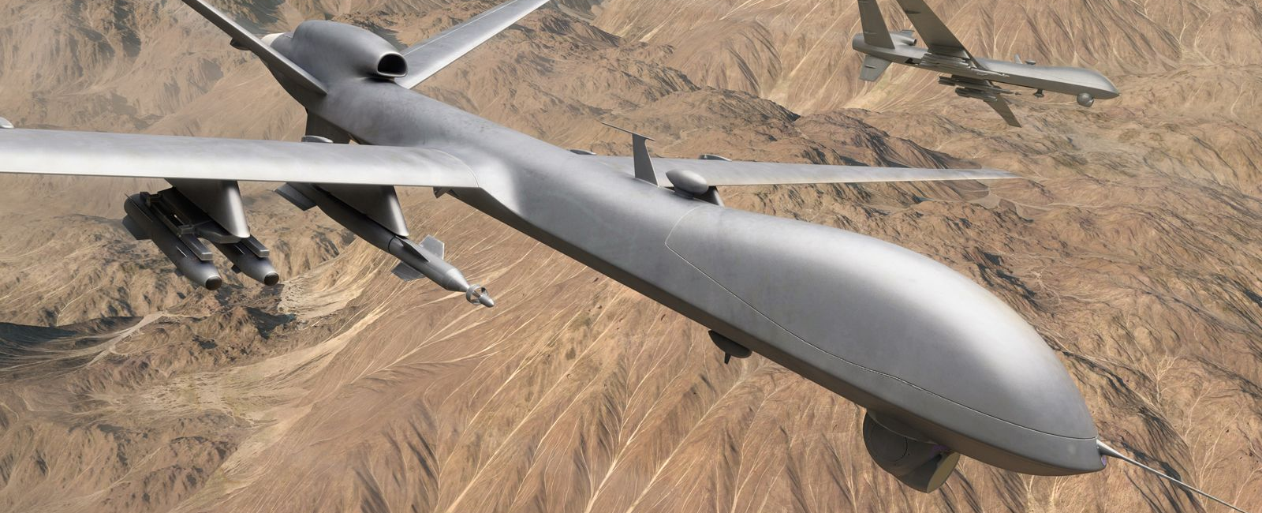
Col R K Sinha’s
GURUDEVAS SSB
ACADEMY | Pune
9890888414/8625888414
• TAPAS-BH-201 (Rustom-II) — MALE UAV — Feb 2025 (user evaluation)
• Weaponised UAV systems — Armed drones — 2025 (multiple trials)
• Loitering Munitions (Indian) — Kamikaze drones — 2024–25 (operational induction)
Indigenous Drones / UAV Weapon Systems Tested

Slide 20
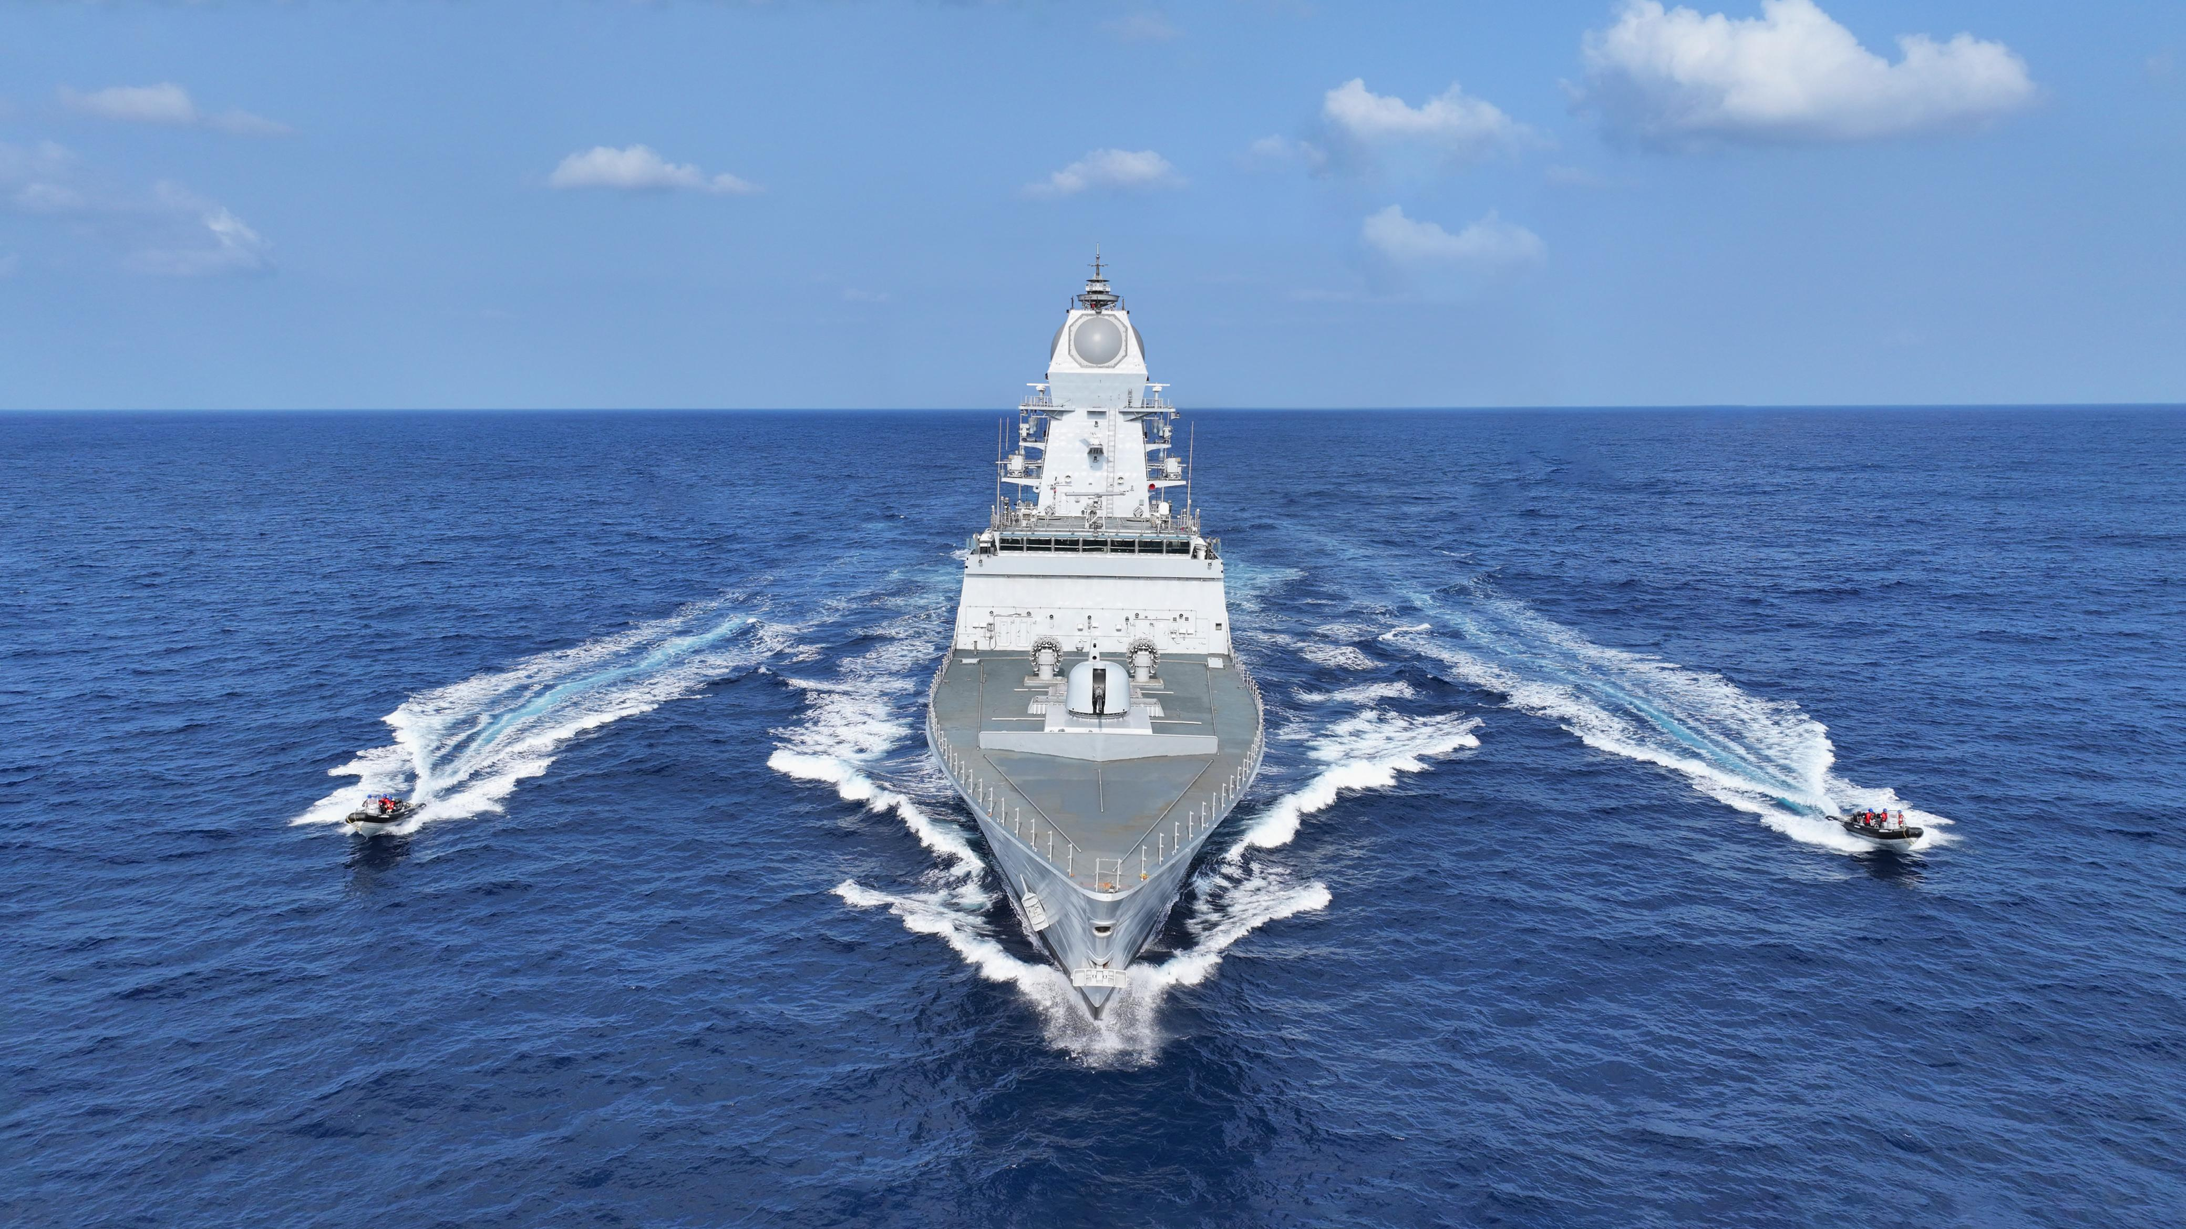
Col R K Sinha’s
GURUDEVAS SSB
ACADEMY | Pune
9890888414/8625888414
• INS Udaygiri — Project 17A stealth frigate — 26 Aug 2025
• INS Himgiri — Project 17A stealth guided-missile frigate — 26 Aug 2025
• INS Surat — Project 15B guided-missile destroyer — Dec 2024
• INS Ikshak — Survey vessel (SVL class) — 14 Aug 2025
Naval Platforms Commissioned (India)

Slide 21
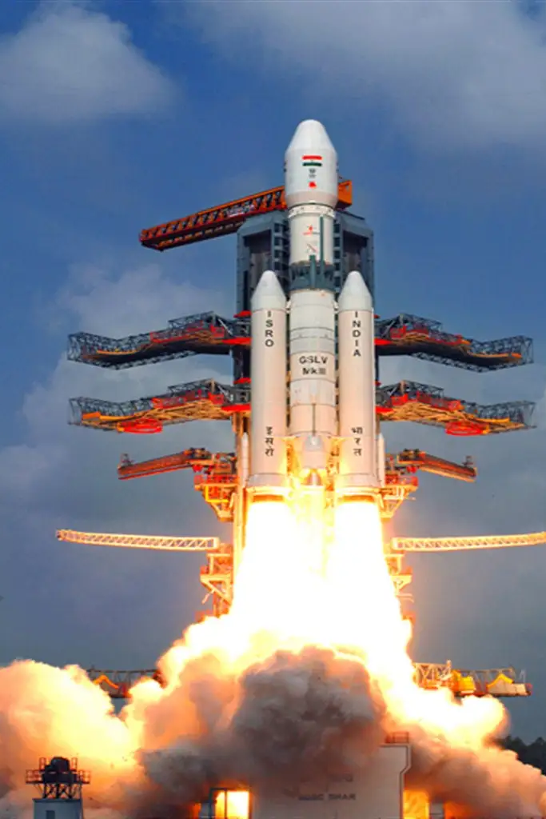
Space & Advanced Technology (2025)
Col R K Sinha’s
GURUDEVAS SSB
ACADEMY | Pune
9890888414/8625888414
Major Space Missions (2025)
Navigation & Communication
• NVS-02 navigation satellite
– Launched: 29 January 2025
– Launch Vehicle: GSLV-F15
– Strengthened NavIC system
Earth Observation
• NISAR (NASA-ISRO SAR Mission)
– Launched: 30 July 2025
– Mission cost: ~USD 1.5 billion
Heavy Satellites
• GSAT-7R / CMS-03 — 4,410 kg
• BlueBird-6 (Block-2) — 6,100 kg
– Heaviest payload launched from Indian soil

Slide 22
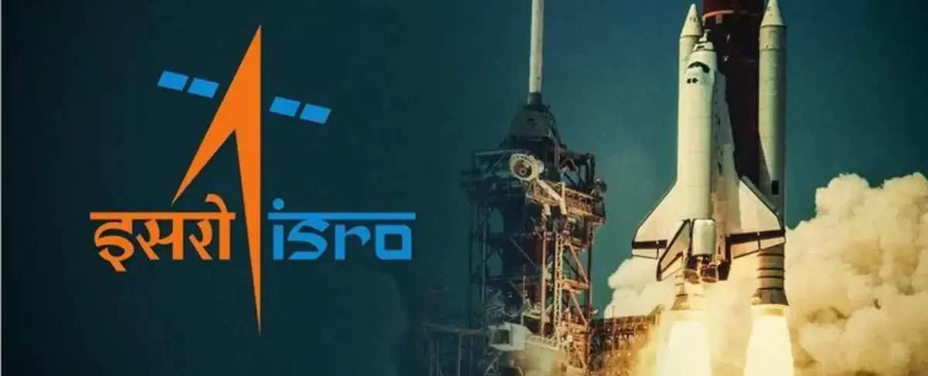
Historic Space Milestones (2025)
• ISRO’s 100th orbital launch achieved
• India became the 4th country globally to demonstrate satellite docking capability
• Expansion of NavIC satellite constellation
Launch Vehicles & Ecosystem
• LVM3: Proven heavy-lift launcher
• GSLV series: Advanced cryogenic capability
Private Space Sector
• 300+ space startups active
• Vikram-1 (Skyroot Aerospace) — first private orbital rocket (ready)

Slide 23
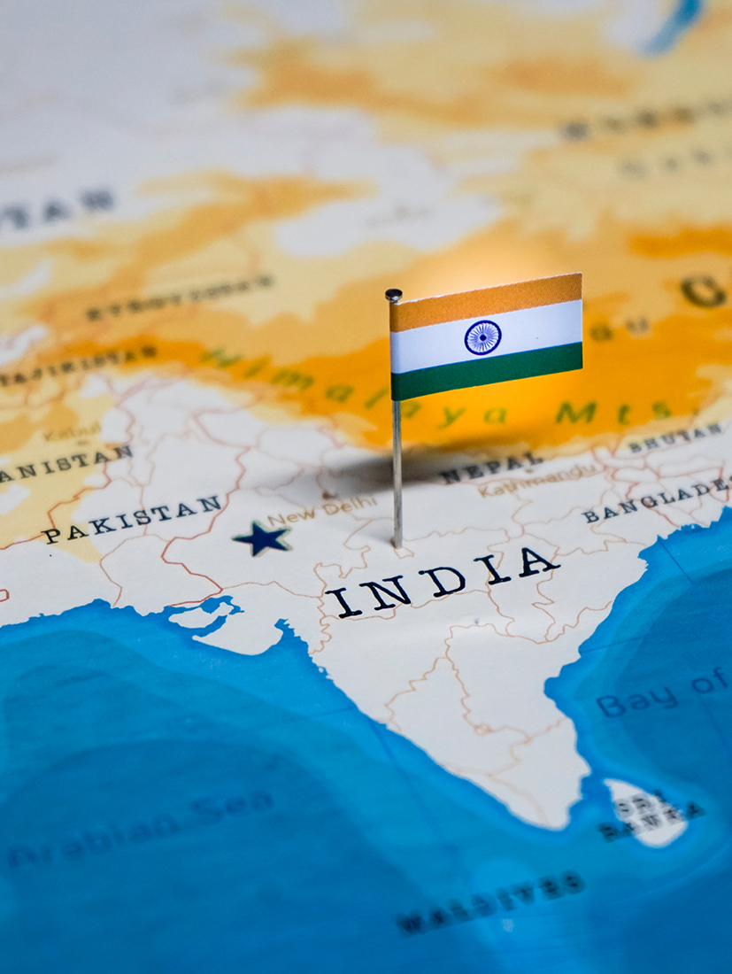
India’s Global Image (2025)
Col R K Sinha’s
GURUDEVAS SSB
ACADEMY | Pune
9890888414/8625888414
Reliable economic partner
Space & technology collaborator
Voice of Global South
Strong G20 and multilateral role

Slide 24
Final Message
Col R K Sinha’s
GURUDEVAS SSB
ACADEMY | Pune
9890888414/8625888414
India’s 2025 performance reflects durable economic strength
Public investment and reform-driven growth position India as a global engine

Slide 25
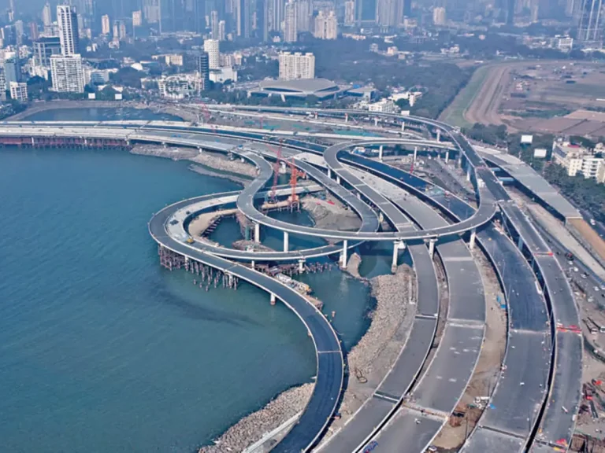
Col R K Sinha’s
GURUDEVAS SSB
ACADEMY | Pune
9890888414/8625888414
Thank you

